Slide 1
PythonDS-21 Inner Classes
Dr. Naveen Kumar
Associate Professor
Amity Institute of Information Technology
Amity University Patna

Slide 2
Introduction to Classes and Objects
What is a Class?
In Python, everything is an Object.
A Class is a Blueprint, Model, or Plan used to create objects.
It represents:
Properties: Attributes represented by variables.
Actions: Behavior represented by methods.
What is an Object?
The Physical Existence of a class.
One class can have any number of objects.

Slide 3
Defining a Class in Python
class ClassName:
''' Documentation String '''
# Variables (Instance, Static, Local)
# Methods (Instance, Class, Static)
Documentation String (Docstring):
An optional description of the class.
How to access:
print(ClassName.__doc__)
help(ClassName)

Slide 4
The 'self' Variable
Definition: A default variable that always points to the current object.
Role: Used to access instance variables and instance methods.
Strict Rules:
Must be the first parameter inside a constructor: def __init__(self):
Must be the first parameter inside instance methods: def talk(self):
Note: It is similar to the this keyword in Java.

Slide 5
The Constructor (__init__)
Purpose: To declare and initialize instance variables.
Key Features:
Special method named __init__(self).
Executes automatically during object creation.
Executes only once per object.
Optional; Python provides a default constructor if none is defined.
Example:
def __init__(self, name, rollno):
self.name = name
self.rollno = rollno

Slide 6
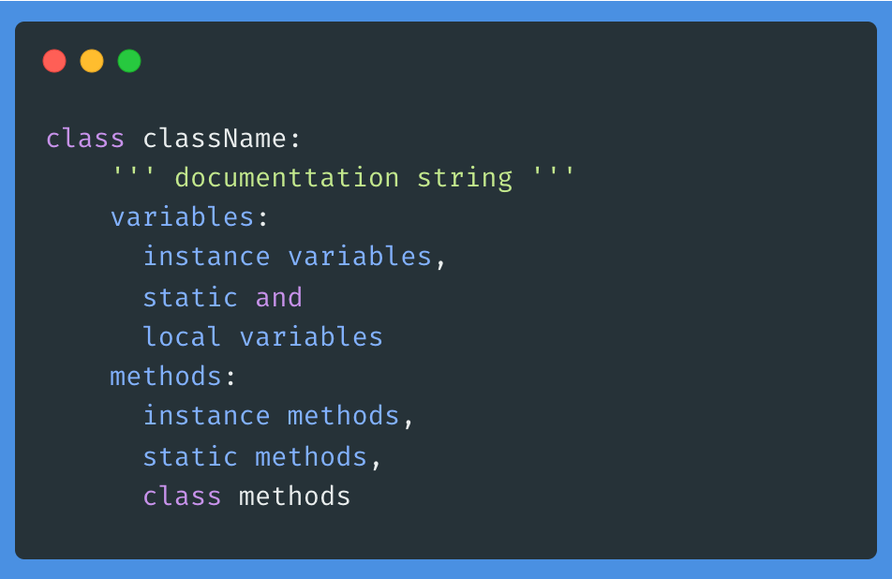
Defining a Class
We can define a class by using class keyword.
Documentation string represents description of the class. Within the class doc string is always optional. We can get doc string by using the following 2 ways.
1. print(classname.__doc__)
2. help(classname)

Slide 7
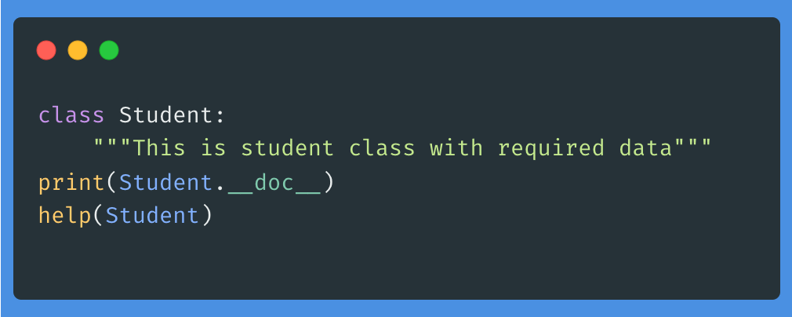

Slide 8
Types of Variables in Python
Instance Variables (Object Level):
Value varies from object to object.
Separate copy for every object.
Static Variables (Class Level):
Value is shared by all objects.
Only one copy exists for the entire class.
Local Variables (Method Level):
Created for temporary requirements within a method.
Destroyed once the method execution finishes.

Slide 9
Working with Instance Variables
Declaration Places:
Inside Constructor (using self).
Inside Instance Method (using self).
Outside the class (using object reference).
Accessing: Use self (inside class) or object_ref (outside class).
Deletion:
del self.variableName
del object_ref.variableName

Slide 10
Working with Static Variables
Declaration: Generally declared directly inside the class but outside methods.
Accessing: Recommended to use Class Name, though object reference works.
Modification:
Must use Class Name or cls.
Warning: If you use self.static_var = value, it creates a new instance variable instead of modifying the static one.

Slide 11
Types of Methods
Instance Methods:
Use instance variables.
Requires self parameter.
Class Methods:
Use only static/class variables.
Marked with @classmethod decorator.
Requires cls parameter.
Static Methods:
General utility methods (no self or cls needed).
Marked with @staticmethod decorator.

Slide 12
Accessor and Mutator Methods
Setter (Mutator) Methods:
Used to set/modify values of instance variables.
def setName(self, name): self.name = name
Getter (Accessor) Methods:
Used to retrieve values of instance variables.
def getName(self): return self.name

Slide 13
Passing Members Between Classes
Objects of one class can be passed as arguments to methods of another class.
Example Scenario:
An Employee class stores data.
A Manager or Test class has a method that accepts an Employee object and modifies its salary.

Slide 14
Member Variables and Member Methods
Within the Python class, we can represent data by using variables. There are 3 types of variables allowed.
1. Instance Variables (Object Level Variables)
2. Static Variables (Class Level Variables)
3. Local variables (Method Level Variables)
Within the Python class, we can represent operations by using methods. The following are various types of allowed methods.
1. Instance Methods
2. Class Methods
3. Static Methods

Slide 15
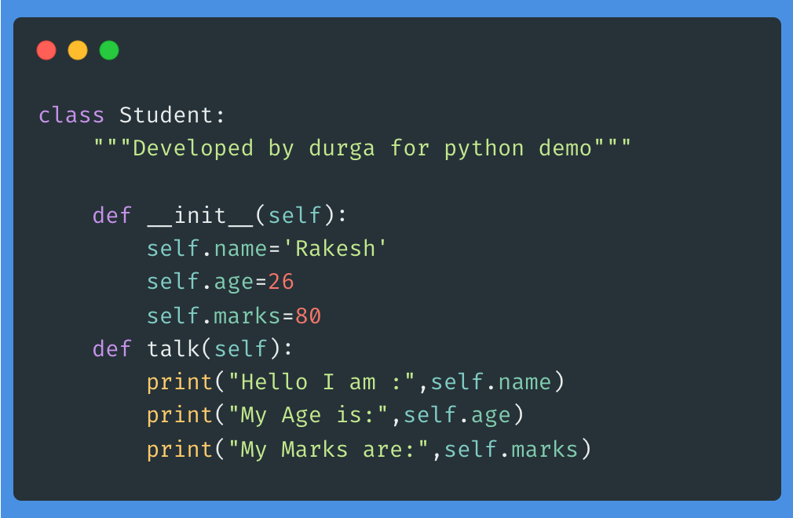

Slide 16
toString() implementation in Python
In Python, the equivalent of the toString() method in other object-oriented languages like Java is achieved by implementing the special __str__() and __repr__() "dunder" (double underscore) methods within a class. These methods control how an object is converted to a string in different contexts.
__str__(): Provides a user-friendly or "informal" string representation of an object, intended for display to end-users (e.g., when using print(obj) or str(obj)). The result should be readable and concise.
__repr__(): Provides a detailed, developer-oriented or "official" string representation, primarily for debugging and logging. The goal is to be unambiguous, and ideally, the output should be a valid Python expression that could be used to recreate the object (e.g., in an interpreter session).

Slide 17
Implementation Example
It is recommended to implement both for maximum utility. By default, if only __repr__() is defined, str() calls repr()
Python does not have a method explicitly named toString().
The str() built-in function is used to convert an object to a string.
Implementing __str__() and __repr__() in your custom classes gives you control over how your objects are represented as strings.
When you print an object, the __str__() method is automatically invoked.

Slide 18
Object
Pysical existence of a class is nothing but object.
We can create any number of objects for a class.
Syntax to create object: referencevariable = classname()
Example: s = Student()
The variable which can be used to refer object is called reference variable.
By using reference variable, we can access properties and methods of object.

Slide 19
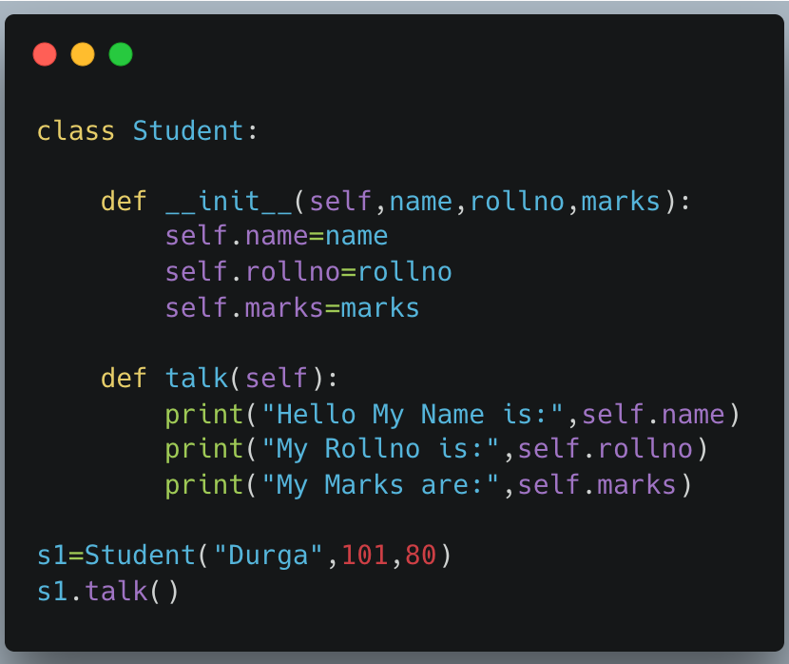

Slide 20
Self variable
self is the default variable, which is always pointing to the current object (like this keyword in Java)
By using self, we can access instance variables and instance methods of an object.
Note:
self should be the first parameter inside the constructor
def __init__(self):
self should be first parameter inside instance methods
def talk(self):

Slide 21
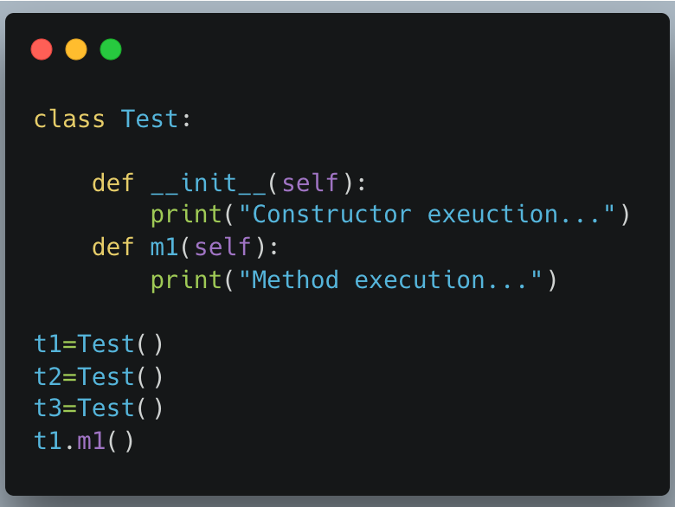

Slide 22
Differences between Methods and Constructors
Method | Constructor
1. Name of method can be any name | 1. Constructor name should be always __init__
2. Method will be executed if we call that method. | 2. Constructor will be executed automatically at the time of object creation.
3. Per object, method can be called any number of times. | 3. Per object, Constructor will be executed only.
4. Inside method we can write business logic. | 4. Inside Constructor we have to declare and initialize instance variables

Slide 23
Constructor Concept
A constructor is a special method in Python.
The name of the constructor should be __init__(self)
The constructor will be executed automatically at the time of object creation.
The main purpose of a constructor is to declare and initialise instance variables.
Per object constructor will be executed only once.
Constructor can take atleast one argument(atleast self)
Constructor is optional and if we are not providing any constructor then python will provide
default constructor.

Slide 24
Passing Members of One Class to Another Class
We can access members of one class inside another class.
1) classEmployee:
2) def __init__(self,eno,ename,esal):
3) self.eno=eno
4) self.ename=ename
5) self.esal=esal
6) def display(self):
7) print('Employee Number:',self.eno)
8) print('Employee Name:',self.ename)
9) print('Employee Salary:',self.esal)
10) class Test:
11) def modify(emp):
12) emp.esal=emp.esal+10000
13) emp.display()
14) e=Employee(100,'Durga',10000)
15) Test.modify(e)

Slide 25
Inner Classes
Sometimes we can declare a class inside another class, such type of classes are called
inner classes.
Without existing one type of object if there is no chance of existing another type of object,
then we should go for inner classes.
Example: Without existing Car object there is no chance of existing Engine object. Hence
Engine class should be part of Car class.

Slide 26
class Car:
.....
class University:
class Engine:
......
Example: Without existing university object there is no chance of existing Department
object
.....
class Department:
......
Example: Without existing Human there is no chance of existin Head. Hence Head
should be part of Human.
class Human:
class Head:
Note: Without existing outer class object there is no chance of existing inner class object.
Hence inner class object is always associated with outer class object.

Slide 27
1) classOuter:
2) def __init__(self):
3) print("outer class object creation")
4) class Inner:
5) def __init__(self):
6) print("inner class object creation")
7) def m1(self):
8) print("inner class method")
9) o=Outer()
10) i=o.Inner()
11) i.m1()

Slide 28
Note: The following are various possible syntaxes for calling inner class method
3) Outer().Inner().m1() Demo Program-2:
1) o = Outer()
i = o.Inner()
i.m1()
2) i = Outer().Inner()
i.m1()
3) Outer().Inner().m1()

Slide 29
1) classPerson:
2) def __init__(self):
3) self.name='durga'
4) self.db=self.Dob()
5) def display(self):
6) print('Name:',self.name)
7) class Dob:
8) def __init__(self):
9) self.dd=10
10) self.mm=5
11) self.yy=1947
12) def display(self):
13) print('Dob={}/{}/{}'.format(self.dd,self.mm,self.yy))
14) p=Person()
15) p.display()
16) x=p.db
17) x.display()

Slide 30
Garbage Collection
In old languages like C++, programmer is responsible for both creation and destruction of objects.
But neglecting destruction of useless objects, total memory can be filled with useless objects which creates memory problems and total application will be down with Out of memory error.
PVM provides assistant through GC, which is always running in the background to destroy useless objects. Hence the chance of failing Python program with memory problems is very less.
Hence the main objective of Garbage Collector is to destroy useless objects.
If an object does not have any reference variable then that object eligible for Garbage Collection.

Slide 31
Enable and disable Garbage Collector
By default Gargbage collector is enabled, but we can disable based on our requirement. In this context we can use the following functions of gc module.
1) gc.isenabled() # Returns True if GC enabled
2) gc.disable()# To disable GC explicitly
3) gc.enable()#To enable GC explicitly
import gc
print(gc.isenabled()) # True
gc.disable()
print(gc.isenabled()) # False
gc.enable()
print(gc.isenabled()) # True

Slide 32
Destructors
Destructor is a special method and the name should be __del__
Just before destroying an object Garbage Collector always calls destructor to perform clean up activities (Resource deallocation activities like close database connection etc).
Once destructor execution completed then Garbage Collector automatically destroys that object.
Note: The job of destructor is not to destroy object and it is just to perform clean up activities.

Slide 33
Example
1) import time
2) class Test:
3) def __init__(self):
4) print("Object Initialization...")
5) def __del__(self):
6) print("Fulfilling Last Wish and performing clean up activities...") 7)
8) t1=Test()
9) t1=None
10)time.sleep(5)
11) print("End of application")
Output
Object Initialization...
Fulfilling Last Wish and performing clean up activities...
End of application

Slide 34
Note: If the object does not contain any reference variable then only it is eligible fo GC. ie if the reference count is zero then only object eligible for GC.

Slide 35
1) import time
2) class Test:
3) def __init__(self):
4) print("Constructor Execution...")
5) def __del__(self):
6) print("Destructor Execution...")
7)
8) t1=Test()
9) t2=t1
10)t3=t2
11) del t1
12)time.sleep(5)
13) print("object not yet destroyed after deleting t1")
14) del t2
15)time.sleep(5)
16) print("object not yet destroyed even after deleting t2")
17) print("I am trying to delete last reference variable...")
18) del t3

Slide 36
1) import time
2) class Test:
3) def __init__(self):
4) print("Constructor Execution...")
5) def __del__(self):
6) print("Destructor Execution...")
7)
8) list=[Test(),Test(),Test()]
9) del list
10)time.sleep(5)
11) print("End of application")
Output
Constructor Execution...
Constructor Execution...
Constructor Execution...
Destructor Execution...
Destructor Execution...
Destructor Execution...
End of application

Slide 37
Finding the Number of References of an Object
sys module contains getrefcount() function for this purpose.
sys.getrefcount (objectreference)
1) import sys
2) class Test:
3) pass
4) t1=Test()
5) t2=t1
6) t3=t1
7) t4=t1
8) print(sys.getrefcount(t1))
Output 5
Note: For every object, Python internally maintains one default reference variable self.

